Slide 1
HOTEL BOOKING ANALYSIS
CAPSTONE PROJECT
Presented By:
Aswanth.E
(STU.ID : STU664f01cd610d71716453837)

Slide 2
OUTLINE
Problem Statement (Should not include solution)
Proposed System/Solution
System Development Approach (Technology Used)
Result
Conclusion
Future Scope
References

Slide 3
Problem Statement
The project aims to analyze room booking data to identify trends and optimize resource allocation. It involves cleaning and processing raw data, followed by exploratory data analysis to uncover booking patterns and seasonality. The analysis will also focus on identifying peak booking periods and common factors influencing cancellations. Predictive modeling techniques will be employed to forecast future booking trends. The final objective is to provide actionable insights to enhance booking management and improve customer satisfaction. Recommendations will be delivered through detailed reports and visualizations.

Slide 4
Proposed Solution
Data Collection Module: Collects data from various sources such as booking platforms, customer feedback, and internal records.
Data Processing Module: Cleans, preprocesses, and transforms raw data into a structured format suitable for analysis.
Reporting Module: Generates detailed reports on room booking trends, utilization rates, and financial metrics.
Data Integration: Data Sources: Integrates data from multiple booking platforms, CRM systems, financial records, and customer feedback channels
Analytics and Reporting : The room booking data analysis visualization report will provide an interactive and graphical representation of key metrics, trends, and insights, enabling stakeholders to easily understand and make data-driven decisions about room utilization and booking patterns.

Slide 5
System Approach
The "System Approach" section outlines the overall strategy and methodology for developing and implementing the rental bike prediction system. Here's a suggested structure for this section:
System requirements : windows 10 operating system , 8GB RAM, I3 Processor
Library required to build the model : IBM Watsonx assistant

Slide 6
Result
The room booking data analysis project revealed key insights through visualization, including peak booking times, most popular room types, and seasonal trends. It identified high-demand periods and underutilized slots, helping optimize resource allocation. Customer demographics and booking behaviors were visualized, highlighting preferences and potential areas for targeted marketing. The visualizations also demonstrated revenue patterns, aiding in financial planning and strategic decision-making.

Slide 7
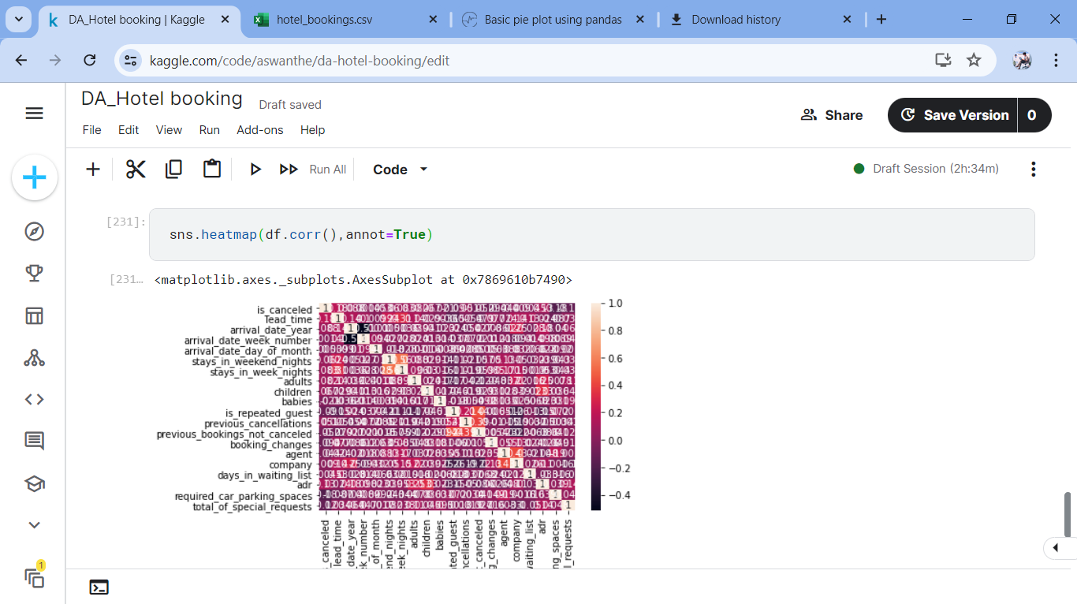
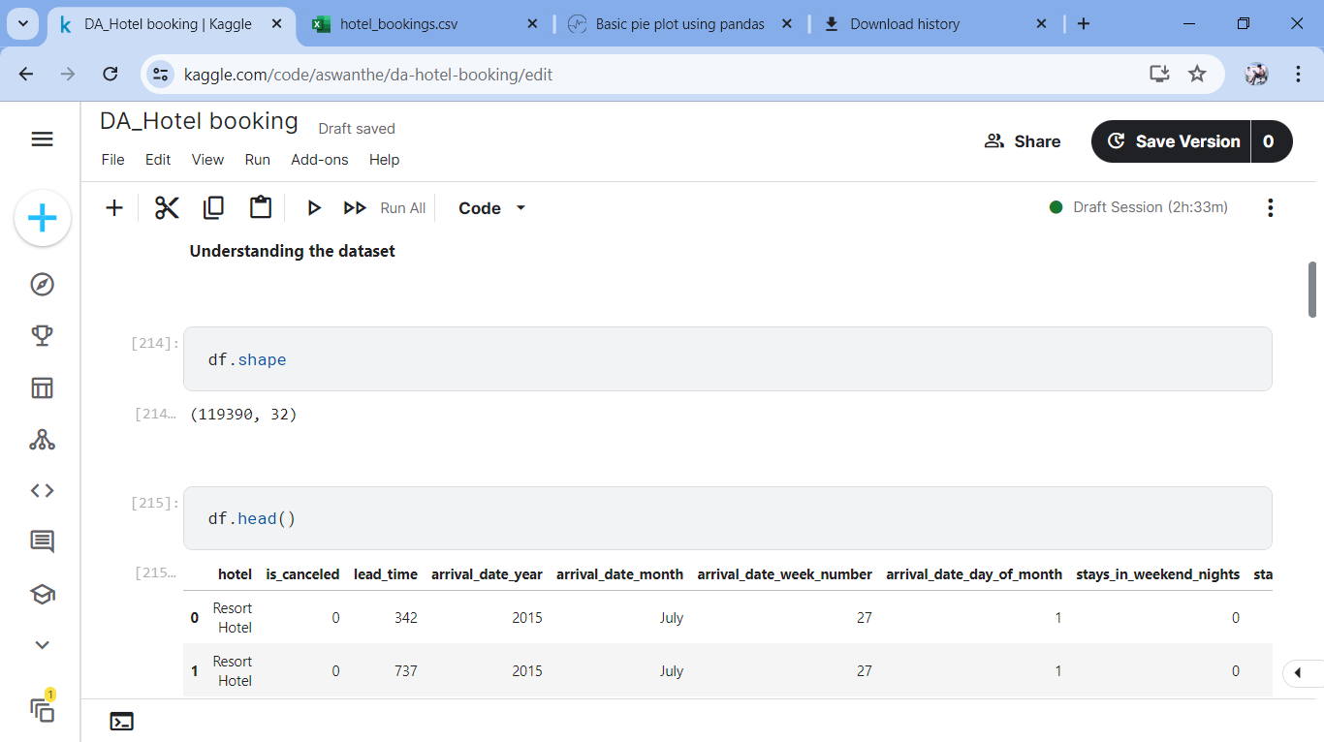
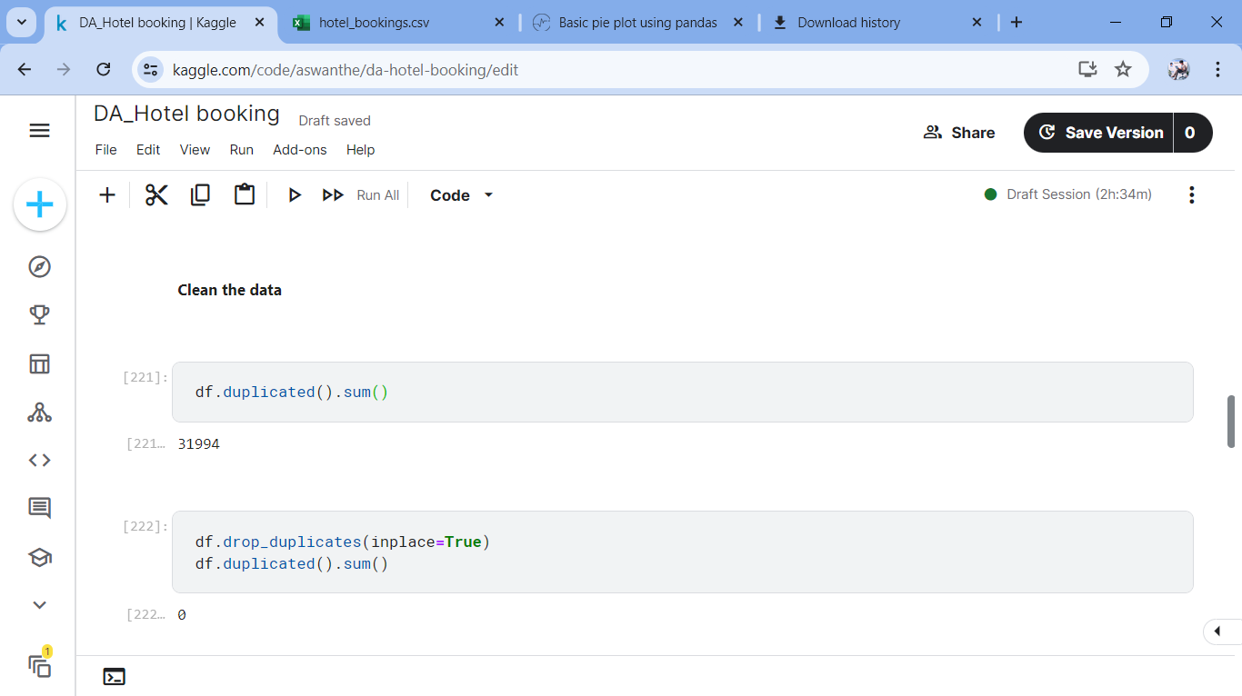
Result

Slide 8
Conclusion
The room booking data analysis project provides a comprehensive solution for optimizing room utilization and enhancing decision-making through advanced analytics and reporting. By integrating data from various sources and employing robust analytical techniques, the system offers valuable insights into booking trends and customer preferences. The user-friendly interface and scalable architecture ensure that the system can grow with organizational needs. Overall, this project aims to improve operational efficiency, increase customer satisfaction, and drive business growth through data-driven strategies.

Slide 9
Future scope
Export Options : Reports in various formats (PDF, Excel, CSV)
Scalability: System designed to handle increasing data volumes
Development Environment : Initial development and testing in a controlled environment
Data Visualization:
Charts and Graphs :Line charts, bar charts, pie charts, and heatmaps .
Interactive filters and drill-down capabilities.

Slide 10
References
IBM Watson studio tutorial
Jupyter Notebook

Slide 11

course certificate 1

Slide 12
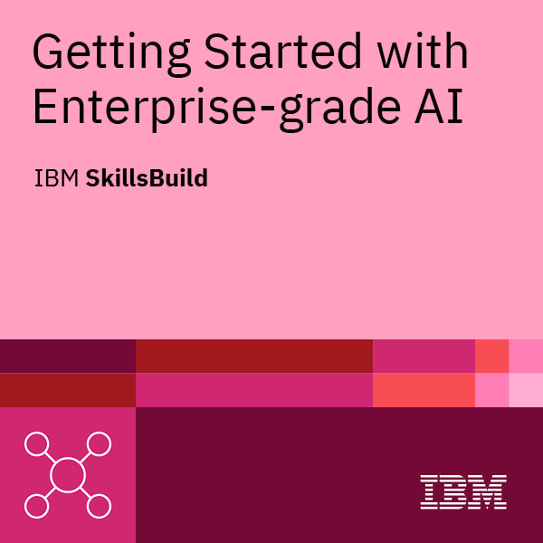
course certificate 2

Slide 13
THANK YOU

